Slide 1

Web Browser Navigation Using Stack (ADT)
CSA0305 – DATA STRUCTURES
PRESENT BY
RAGUL .M
192524066
GUIDE BY
Dr. UMA PRIYADARSINI

Slide 2
INTRODUCTION
What is a Stack?
Stack is a linear data structure.
It follows the LIFO (Last In, First Out) principle.
The last visited webpage is the first one returned when the Back button is pressed.
Operations used:
Push – Store newly visited webpage.
Pop – Remove current webpage while going back.
Peek – Display current webpage.
HOME
GOOGLE
YOUTUBE
GMAIL
GMAIL
YOUTUBE
GOOGLE
HOME

Slide 3
Architecture / Algorithm
Working Process
User opens a webpage.
Browser pushes the page into the stack.
Every new page is pushed on top.
When Back button is clicked, the top page is popped.
Browser displays the previous page

Slide 4
Advantages & Performance
Stack is Suitable
Fast insertion and deletion.
Simple implementation.
Efficient memory usage.
Provides quick Back navigation.
Widely used in Chrome, Firefox, Edge, and other browsers

Slide 5
CONCLUSION
Stack is the most suitable ADT for browser Back navigation.
LIFO perfectly matches browser history behavior.
Push and Pop operations take constant time (O(1)), ensuring fast performance.
Stack improves browsing efficiency and provides a smooth user experience.

Slide 6
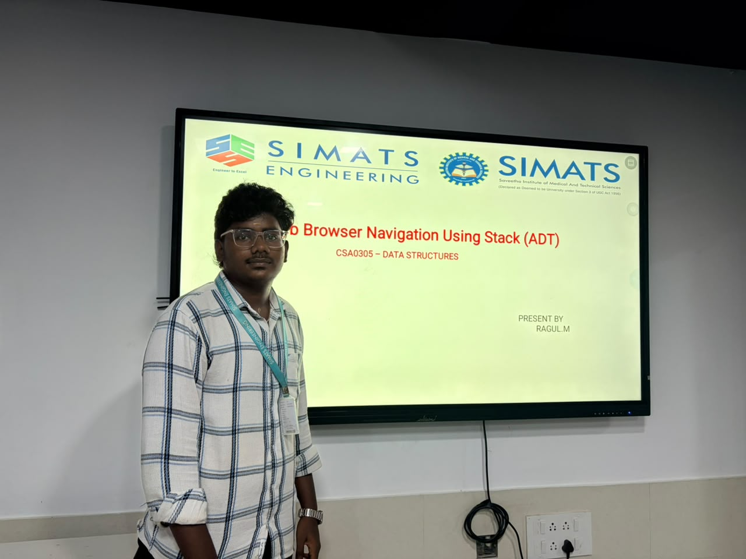
THANK YOU

